Slide 1
Perfect Pallet, Perfect Delivery
Portobello Hackathon 2025
By:
Thomas D. Robertson, Nol Patterson, Maximum Jessey,
Fengjun Han,Silas Webber

Slide 2
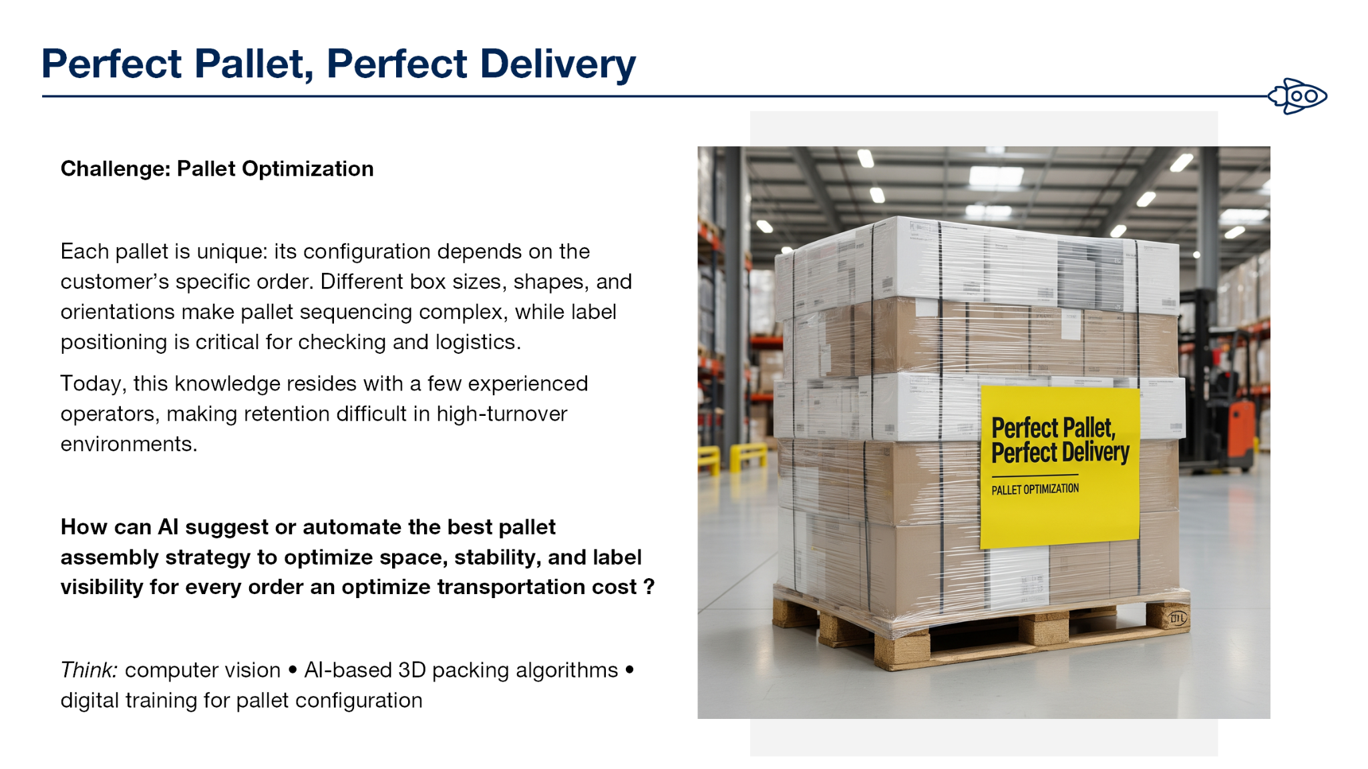

Slide 3
Our Solution: Basic Concepts and Ideas
AI Pallet Optimization
Integrate existing Item Database to store box orders and dimensions
Use python algorithms to simulate Traveling Salesman Optimization and 3D packing Simulation.
Generate 3D heatmaps and visualizations via MatPlotLib for layout and path optimization.
Core Features
Intelligent weight/volume balancing.
Automated label visibility planning - per box structure.
Optimal traversal route generation for workers.
Helps assist new workers with training and time efficiency.

Slide 4
Our Solution: Basic Concepts, Ideas, and Assumptions
AI Pallet Optimization
Integrate into existing Oracle Database to store box order and dimensions
Use various algorithms such as Greedy Algorithm, Monte Carlos Tree Search (MCTS) to determine optimal packing conditions.
Assumes optimal, randomized, and hybrid inventory locations.
Core Features
Intelligent weight/volume balancing.
Automated label visibility planning - per box structure.
Demo Model showing optimal traversal route generation for workers.
Helps assist new workers with training and time efficiency.

Slide 5
AI & Algorithmic Design
Data Integration
Inputs: order details, box dimensions, weight, loading zones
Output: optimized layout visualizations
Optimization Engine
Packing Optimization: 3D bin-packing and weight distribution using heuristics
Traversal Optimization (In-Progress): Traveling Salesman heuristics such as knn, simulated annealing
Visualizations
2D/3D rendering
Loading zones
Pallet loading layouts
Worker routes visualized on Camera layout (Computer Vision Implementation)

Slide 6
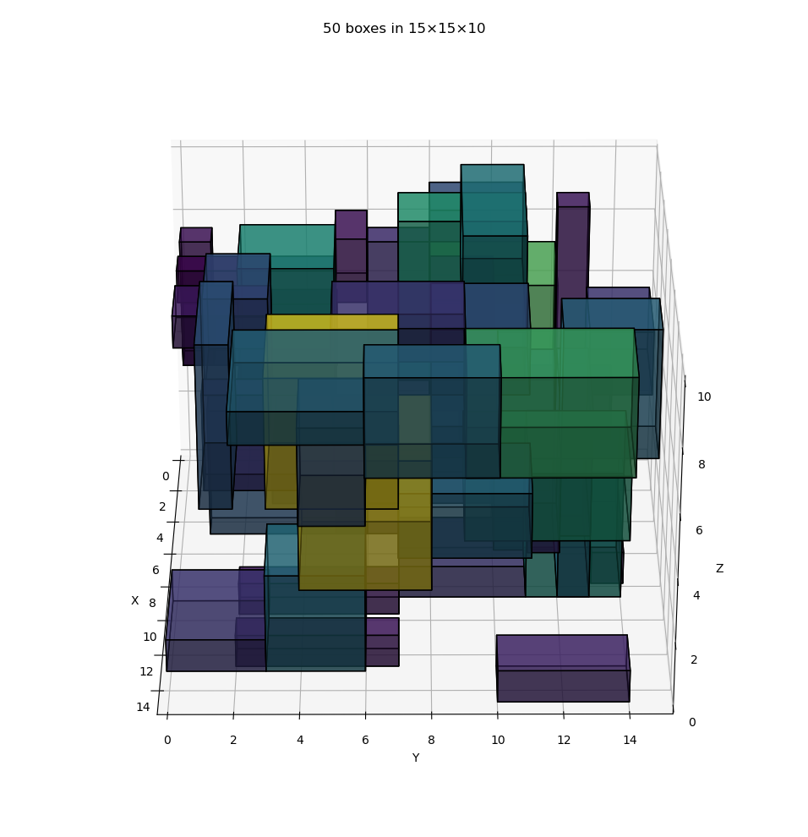
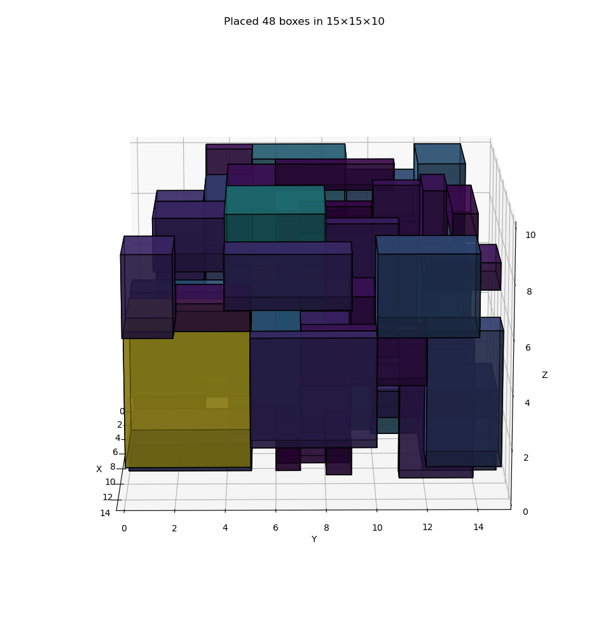
MatPlotLib Visualization

Slide 7
Innovation & Creativity
Combines AI-based pathfinding with 3D space optimization
Integrates directly with Oracle systems currently in place.
Provides digital training capabilities for new workers using visual and data-driven data.
Converts human intuition to replicable AI logic

Slide 8
Business Impact
Warehouse Efficiency - Faster pallet assemblies and reduced worker travel distance.
Cost Reduction - Optimizing packaging reduces wasted space and transport costs
Quality & Consistency - automated label alignment and stable packing for easy scanning
Automated Changes - Adding/removing material simplified and updates routes.

Slide 9
Business Impact
Traveling Salesman Problem - How can we optimize travel time and reduce backtracking?
Business Impact - Optimizing pallet stacking process will speed up shipment preparation, reduce potential for worker injury, and increase return on profit per pallet (ppp).
Scalability - Algorithmic concept can be applied to any amount or number of items.
Return on Investment - Earlier introduction of optimization equates to greater ROI.

Slide 10
Return on Investment & Values
Timeframes:
Short-Term: Reduces inventory configuration time.
Medium-Term: Decreased Shipping costs through space optimization.
Long-Term: Faster employee training through path visualizations.
Efficient Integrations:
Utilizes already existing Oracle Database.
Local models reduce availability concerns.

Slide 11
Feasibility & Scaling
Built using Oracle Python Interface which is fully compatible with existing Oracle Database systems.
Can be expanded to:
Automated robot palletization
Reducing worker exposure to physical injuries.
Real-time sensor weighing using IoT (Highway Transport Compliance)
AI-assisted fleet loading optimization for Transports.
Python modules are easily scalable to cloud or local environments.

Slide 12
Future Ideas:
Integrate computer vision for label scanning and verification.
Adding IoT sensor devices for live weight scanning

Slide 13
Summary:
Our solution aims to bridge data, Artificial Intelligence, and computer visualizations to create a smarter, safer, and more efficient pallet system and working environment.
Optimize space and Stability
Automate worker path planning
Enhance training demands
Aligns with Portobellos Automation Safety focused visions.

Slide 14
Thank you!

